Slide 1
What You
Need to Know
About Financial Aid

Slide 2
Topics We Will Discuss
What is financial aid?
Cost of attendance (COA)
Expected family contribution (EFC)
Financial need
Categories, types, and sources of financial aid
Free Application for Federal Student Aid (FAFSA®)
Special circumstances

Slide 3

What is Financial Aid?
Financial aid consists of funds provided to students and families to help pay for postsecondary educational expenses

Slide 4




What is Cost of Attendance (COA)?
Estimation of expected costs
Direct Costs
Indirect Costs
Tuition and fees
Transportation
Room and board
Miscellaneous
personal expenses
Books and supplies

Slide 5
What is Expected Family Contribution (EFC)?
Measurement of student’s and family’s ability to pay postsecondary educational expenses
Student contribution
Parent contribution
(for dependent students)

Slide 6
What is Financial Need?
Cost of attendance (COA) – Expected family contribution (EFC) = Financial need

Slide 7
Categories of Financial Aid
Need-based aid
Non-need-based aid

Slide 8
Types of Financial Aid
Scholarships
Grants
Work-Study Employment
Loans
Self-Help Aid
Gift Aid

Slide 9
Scholarships
Scholarships
Grants
Work-Study Employment
Loans
Self-Help Aid
Gift Aid

Slide 10
Grants
Scholarships
Grants
Work-Study Employment
Loans
Self-Help Aid
Gift Aid

Slide 11
Work-Study Employment
Scholarships
Grants
Work-Study Employment
Loans
Self-Help Aid
Gift Aid

Slide 12
Loans
Scholarships
Grants
Work-Study Employment
Loans
Self-Help Aid
Gift Aid

Slide 13
Sources of Financial Aid
Federal Government
Employers
States
Private Sources
College and Universities

Slide 14
Federal Government
Largest source of financial aid
Aid awarded primarily on the basis of financial need
Must apply each year using the FAFSA
Eligibility requirements must be met

Slide 15
Federal Student Aid Programs
Federal Pell Grant
Federal Supplemental Educational Opportunity Grant (FSEOG)
Teacher Education Assistance for College and Higher Education (TEACH) Grant
Iraq Afghanistan Service Grant
Federal Work-Study (FWS)
Federal Direct Student Loans (Direct Loans)
Federal PLUS Loans

Slide 16
States - NYS
NYS TAP program – generally full time students
Must be a NYS Resident and must be used at a school in NYS.
Use information from the FAFSA and/or state aid applications
Can apply right from FAFSA – link on the end

Slide 17
States - NYS
NYS Excelsior Scholarship (free tuition)
2019-20 income limit - $125,000
Must be NYS resident attending a SUNY school
Separate application – to open after new year at www.hesc.ny.gov
Must be on track to graduate in 2 or 4 years
Up to tuition only minus other grants and scholarships
Residency requirement

Slide 18
States - NYS
Other grants and scholarships are available
Aid for Part Time Study, Part Time TAP
Veteran’s Tuition Award
World Trade Center Scholarship
Merit Scholarship
Several Others
www.hesc.ny.gov

Slide 19
Colleges and Universities
Award aid on the basis of both merit and need
Aid may be gift aid or self-help aid
Use information from the FAFSA and/or institutional applications
Deadlines and application requirements vary by
institution

Slide 20
Private Sources
Foundations, businesses, churches, civic, and charitable organizations
Deadlines and applications procedures vary
Begin researching private sources early

Slide 21
Employers
Companies may have scholarships available to the children of employees
Companies may have educational benefits for their employees

Slide 22
FAFSA
Collects demographic and financial information
Information used to calculate the expected family contribution (EFC)
Colleges use EFC to award financial aid
Available in English and Spanish

Slide 23
FAFSA
May be filed at any time during an academic year, but no earlier than October 1st prior to the academic year for which the student requests aid
For the 2019-20 academic year, the FAFSA may be filed beginning October 1, 2018
Most colleges set FAFSA filing deadlines

Slide 24





Free Application for Federal Student Aid (FAFSA®)
FAFSA on the Web (FOTW)
myStudentAid mobile app
Paper or PDF FAFSA
FAA Access to CPS Online
FAFSA on the Phone (FOTP)

Slide 25
Benefits of Using FOTW or myStudentAid
Built-in edits to prevent costly errors
Skip-logic allows student and/or parent to skip unnecessary questions
Option to use Internal Revenue Service (IRS) Data Retrieval Tool to import tax data

Slide 26
Benefits of Using FOTW or myStudentAid
More timely submission of original application and any necessary corrections
More detailed instructions and “help” for common questions
Ability to check application status online
Simplified application process in the future

Slide 27
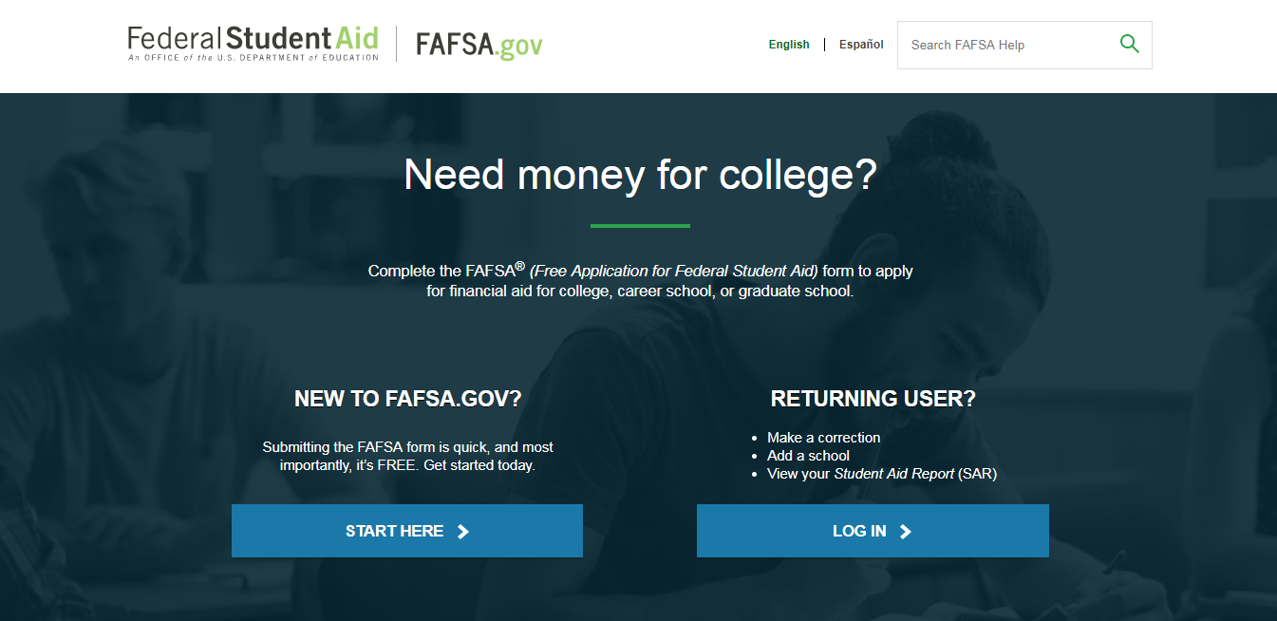
FAFSA on the Web (FOTW)

Slide 28
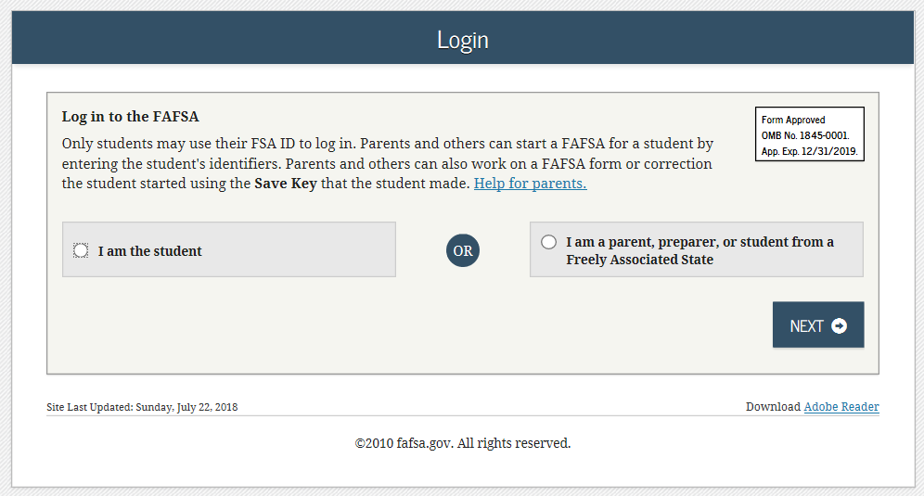
FAFSA on the Web (FOTW)

Slide 29

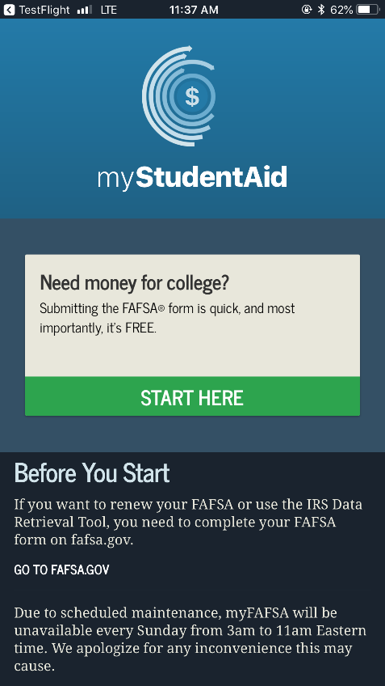
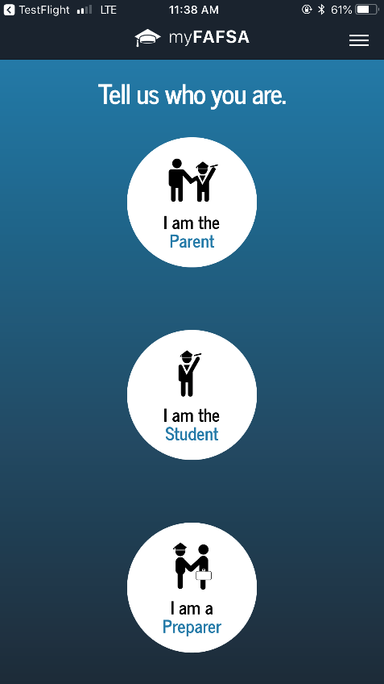
myStudentAid Mobile App
Mobile ability to begin, complete, save, and submit the FAFSA

Slide 30
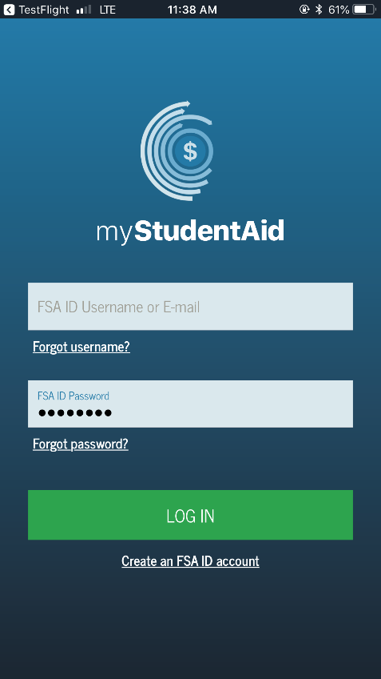
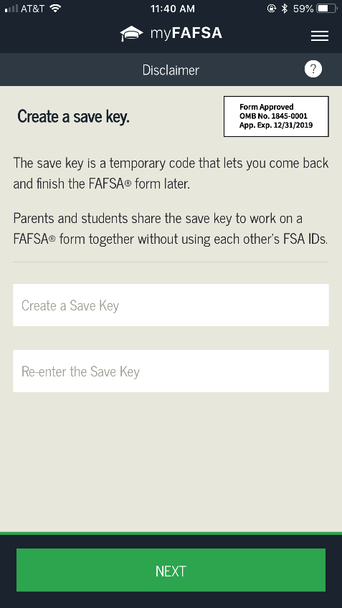
myStudentAid Mobile App
Information protected the same as FOTW
Prompts applicant to create a save key, allowing completion at later time

Slide 31
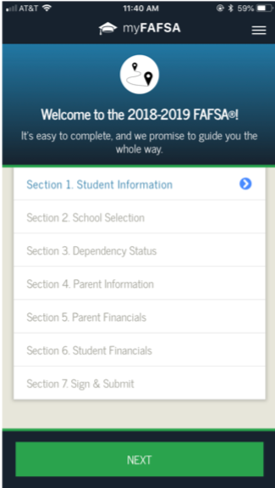
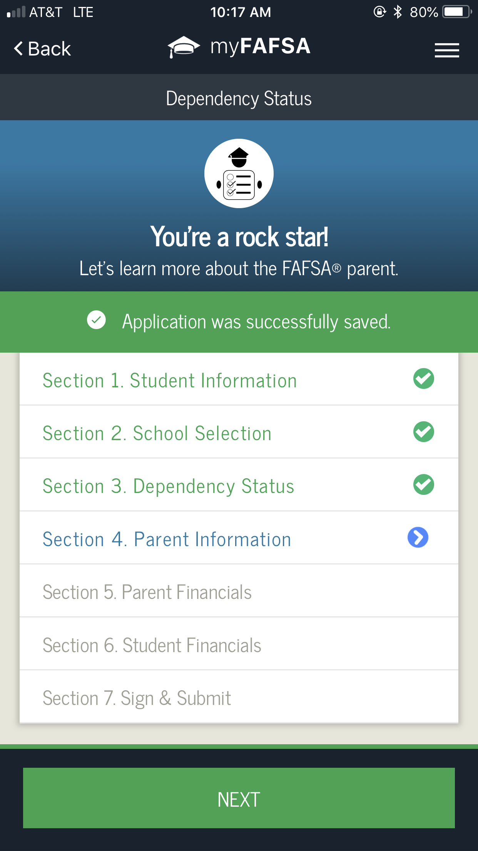
myStudentAid Mobile App
FAFSA completion tracked
Successful completion of each section indicated

Slide 32
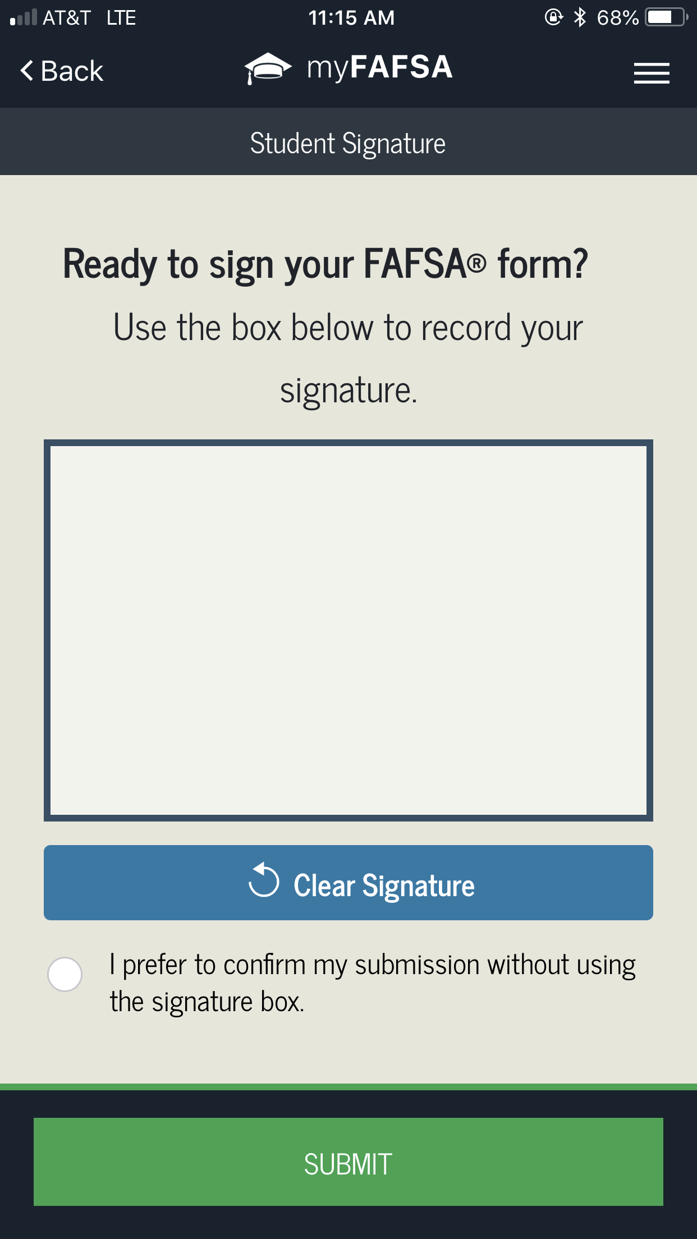
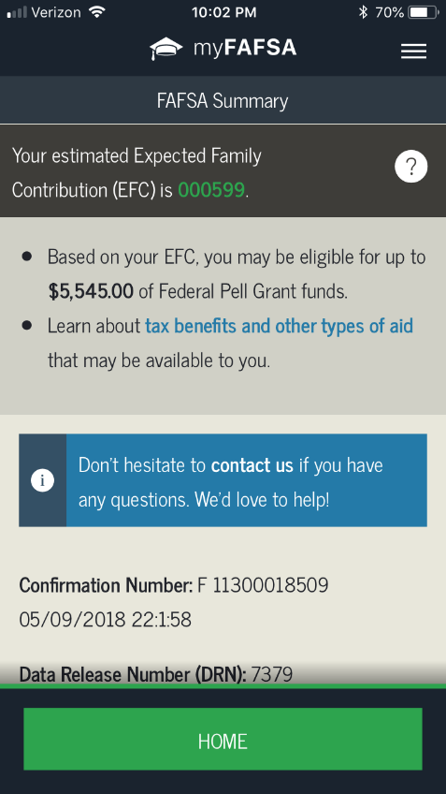
myStudentAid Mobile App
Digital signature
Confirmation of submission
Estimated EFC calculation

Slide 33
IRS Data Retrieval Tool
Allows for certain tax return information to be transferred from the IRS database
Participation is voluntary and student chooses whether or not to transfer data to FOTW
IRS will authenticate taxpayer’s identity
If tax record is found, IRS transfers information to populate the FAFSA
Reduces documents requested by financial aid office

Slide 34
IRS Data Retrieval Tool
Certain tax filers cannot use the
IRS Data Retrieval Tool
Did not indicate on FAFSA a tax return was completed
Marriage date is January 2017, or later
First three digits of the SSN are 666
Filed a non-U.S. tax return
Married and filed as head of household, or filed separate returns
Neither married parent entered a valid SSN
Non-married parent or both married parents entered all zeroes for the SSN

Slide 35
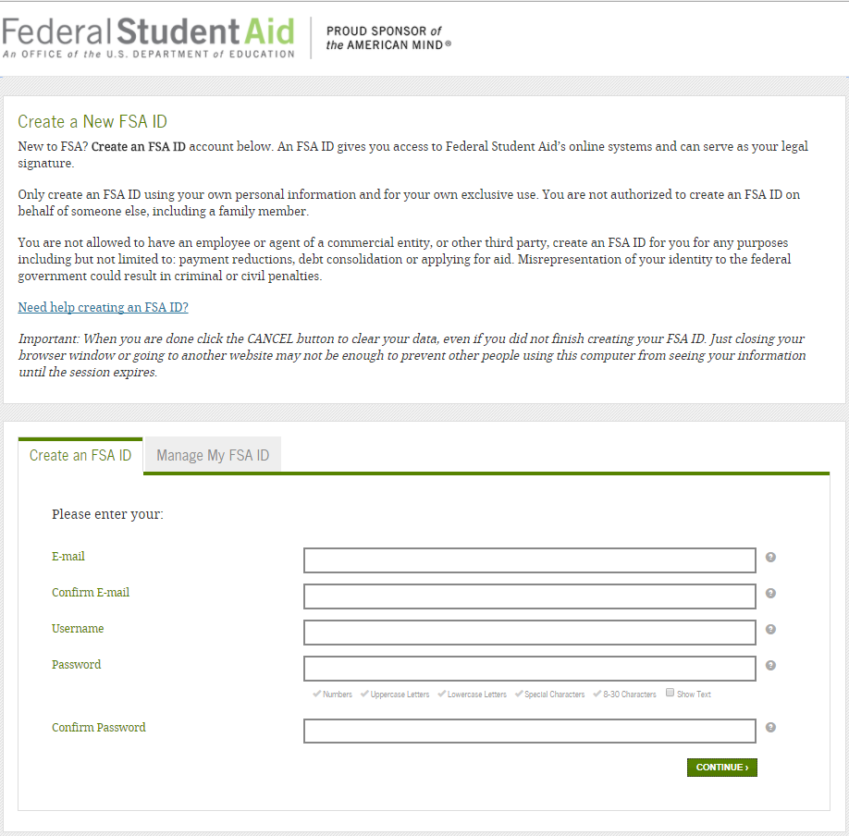
FSA ID
Used for FAFSA completion and allows access to certain U.S. Department of Education websites
May be used by students and parents throughout financial aid process, including subsequent school years
Only the owner should create a FSA ID
Apply at https://fsaid.ed.gov/npas/index.htm

Slide 36
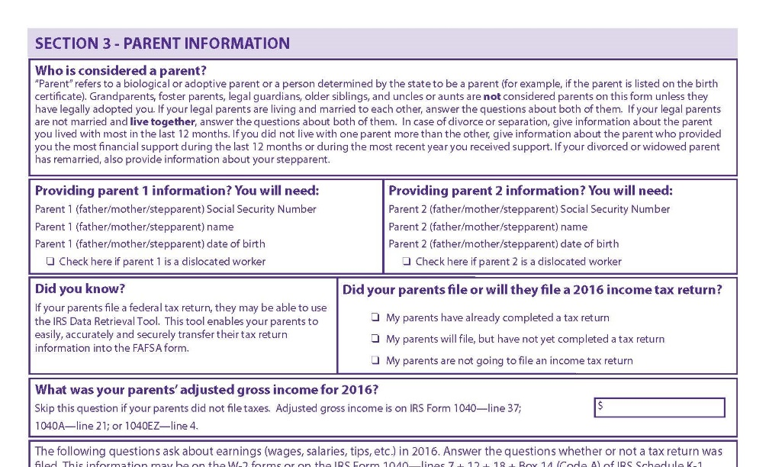
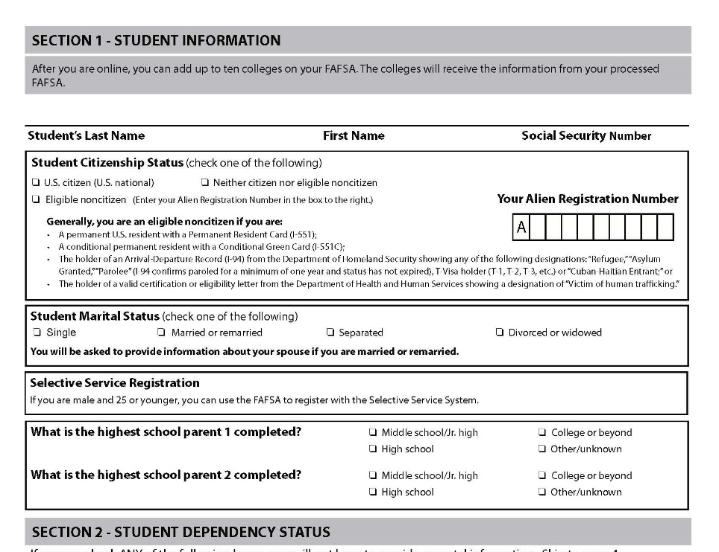
FOTW Worksheet
Preview of questions that may be asked regarding basic information for the student and parent, if applicable

Slide 37
General Student Information
Social Security Number
Citizenship status
Marital status
Drug conviction of possession or sale
Selective Service registration
Highest education level completed by father/mother

Slide 38
Student Dependency Status
FAFSA asks questions to determine dependency status for Title IV federal student aid (not IRS) purposes:
If all “No” responses, student is dependent
If “Yes” to any question, student is independent

Slide 39
Determining Dependency Status
Were you born before 1/1/96?
Are you married?
Will you be working on a grad program?
Are you currently serving active duty military?
Are you a veteran?
Do you have dependents other than a spouse providing more than 50% support?

Slide 40
Determining Dependency Status – cont.
Are you an orphan or ward of the court? (anytime after age 13)
Are you an emancipated minor? (always no in NY)
Does someone have court-appointed legal guardianship of you?
At any time after 7/1/18 were you determined to be an unaccompanied youth who was homeless as determined by your HS, director of an emergency shelter, or director of a runaway or homeless youth basic center or transitional living program?

Slide 41
Information About Parents of
Dependent Students
Tax, income, and other financial information
Dislocated worker status
Receipt of means-tested federal benefits in the previous two years
Assets
Untaxed income

Slide 42
Information About Student
(and Spouse)
Tax, income, and other financial information
Dislocated worker status
Receipt of means-tested federal benefits in the previous two years
Assets
Untaxed income

Slide 43
Additional Information
College information
Housing plans
FAFSA preparer information

Slide 44
Signatures
Required
  Student
  One parent (dependent students)
Format for submitting signatures
  Electronic using FSA ID
  Signature page
  Paper FAFSA

Slide 45
Frequent FAFSA Errors
Social Security Numbers
Divorced/widowed/remarried parental information
Income earned by parents/stepparents
Untaxed income
U.S. income taxes paid
Household size
Number of household members in college
Real estate and investment net worth

Slide 46



FAFSA Processing Results
CPS
College
Student

Slide 47
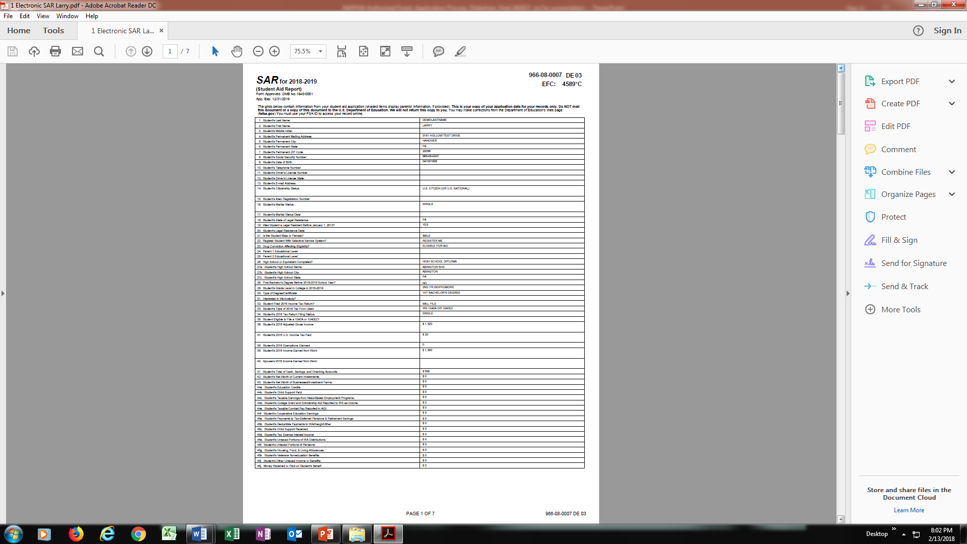
Email Notification of SAR Processing
If valid email address is provided on FAFSA
Provides access to electronic SAR at www.fafsa.gov

Slide 48
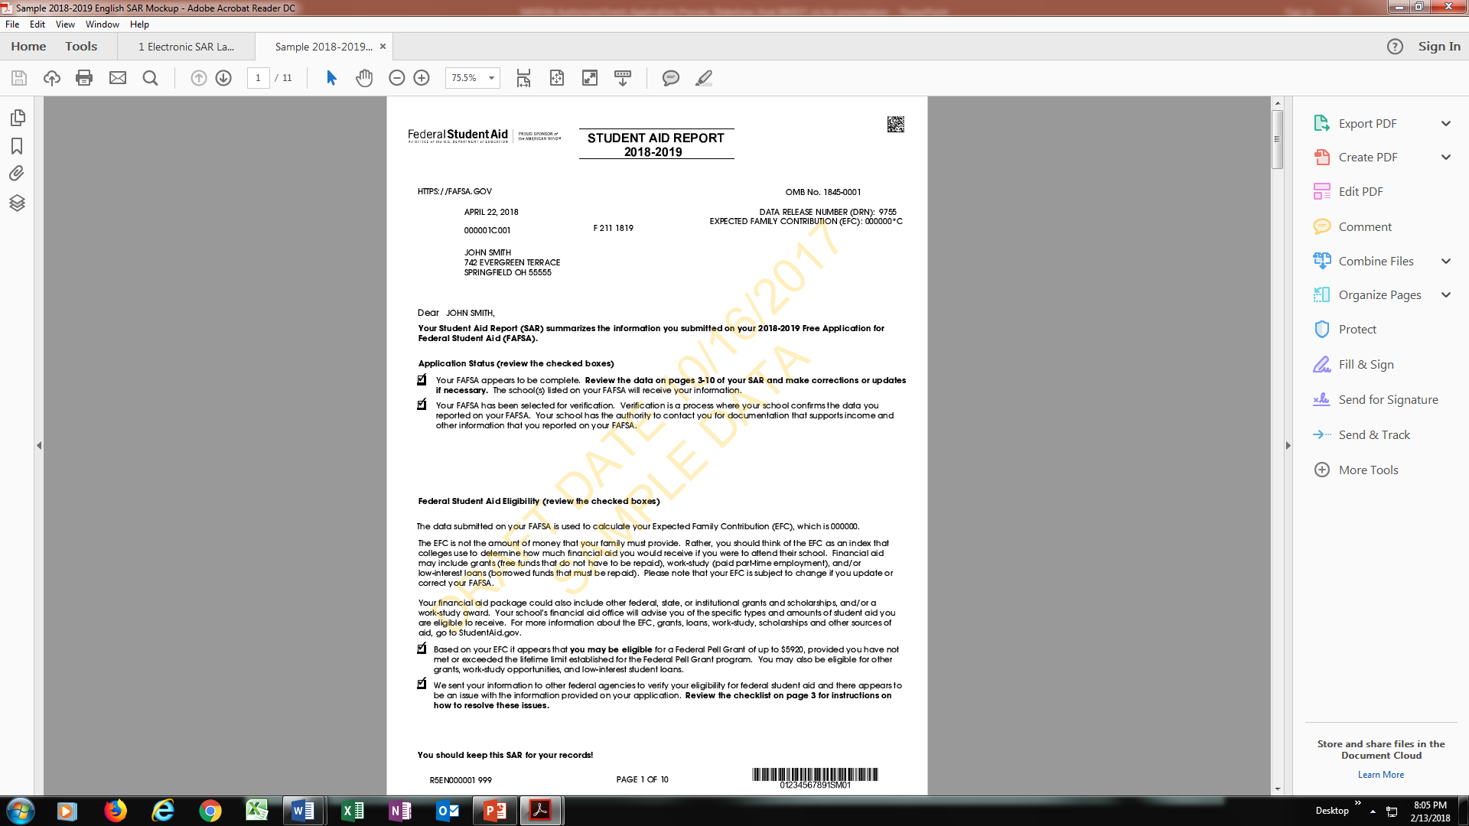
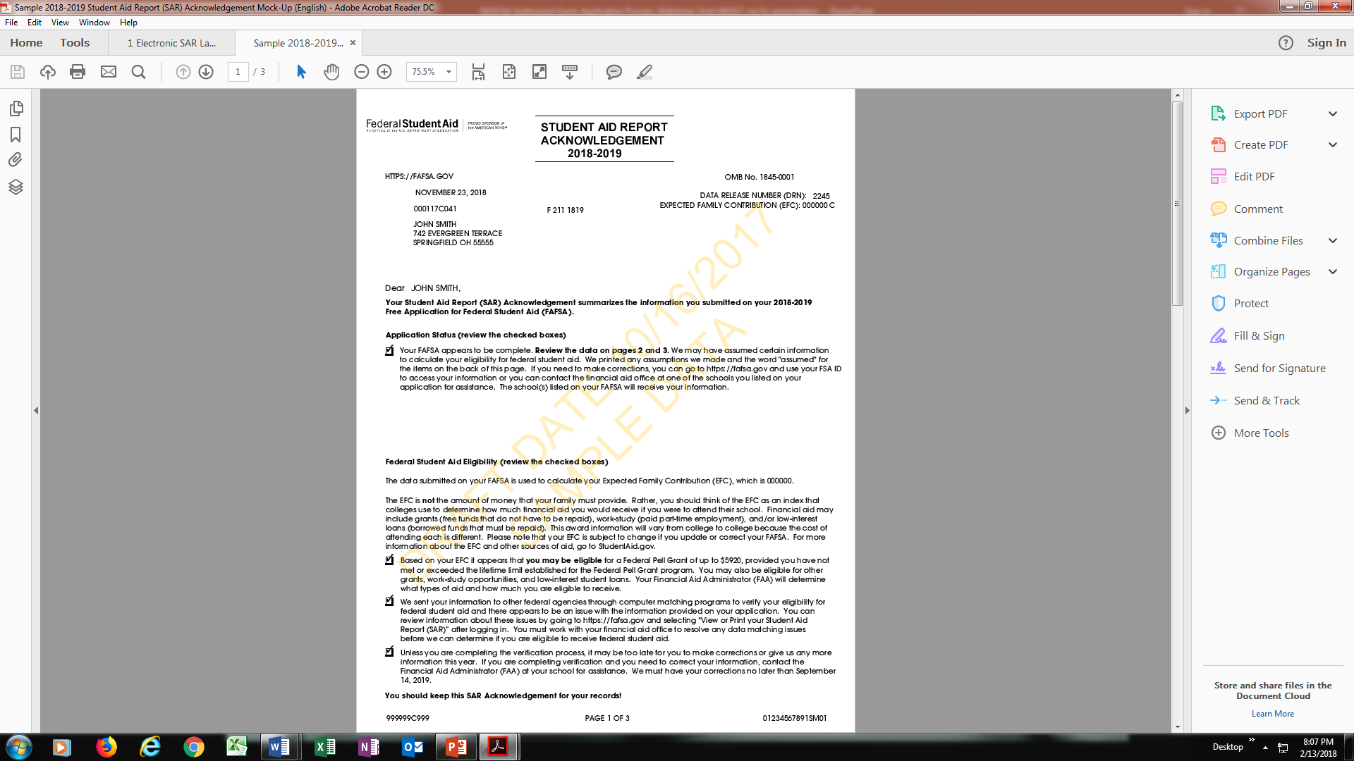
SAR or SAR Acknowledgement
SAR sent if paper FAFSA filed without providing an email address
SAR Acknowledgement sent if FOTW filed without providing an email address

Slide 49
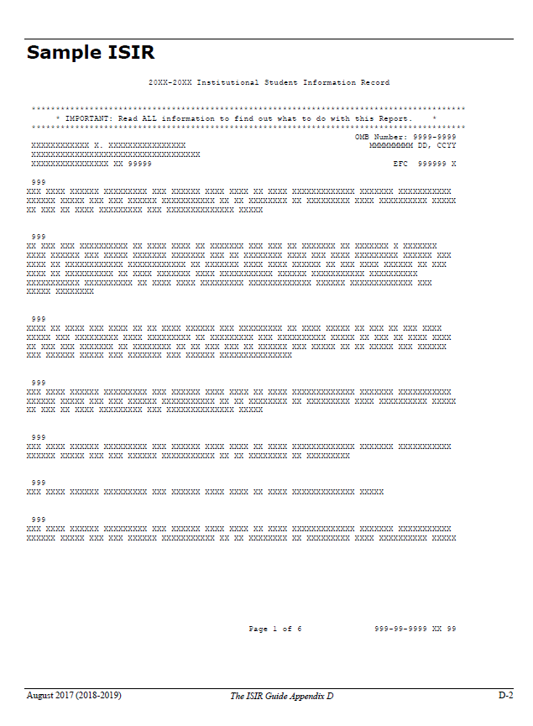
Institutional Student Information Record (ISIR)
CPS sends results to colleges listed on the FAFSA
College reviews ISIR and may request additional documentation

Slide 50
Making Corrections
If necessary, corrections to FAFSA data may be made by:
Using FAFSA on the Web, if student has a FSA ID;
Updating paper SAR; or
Submitting documentation to college’s financial aid office

Slide 51
Special Circumstances
Conditions exist that cannot be documented with the FAFSA
Send written explanation and documentation to your college’s financial aid office
College will review and request additional information if necessary
Decisions are final and cannot be appealed to U.S. Department of Education

Slide 52

Special Circumstances
Secondary school tuition
Unusual uncovered medical/dental expenses
Extraordinary dependent care
Student cannot obtain parental information
Parent or spouse death
Loss of employment
Divorce

